Slide 1
Created By : Ayush Sahane (a1984073)
Tumor Trace - Brain Tumor Detection System

Slide 2
THE PROBLEM!
330K+
New Brain Tumor Cases Diagnose Globally Per Year.
Early detection = 2x
survival improvement

Slide 3
OBJECTIVES
Automation
Accuracy
Automate brain tumor detection using CNN.
Achieve >= 95% accuracy
Minimization
User Interface
Provide simple clinical User Interface (UI)
Minimize false positive/negatives.

Slide 4
Dataset & Tools
MRI brain scans collected from Kaggle medical imaging datasets.
Binary classification: Tumor vs No Tumor
Preprocessing pipeline ensures consistent input quality.
Tools used: TensorFlow, Keras, OpenCV, Streamlit

Slide 5
Preprocessing
Converts MRI scans to consistent 50x50 resolution.
Apply Gaussian filtering for noise reduction.
Normalize pixel values to stabilize training.
Crop brain region using contour detection.
Remove background artifacts for cleaner input

Slide 6
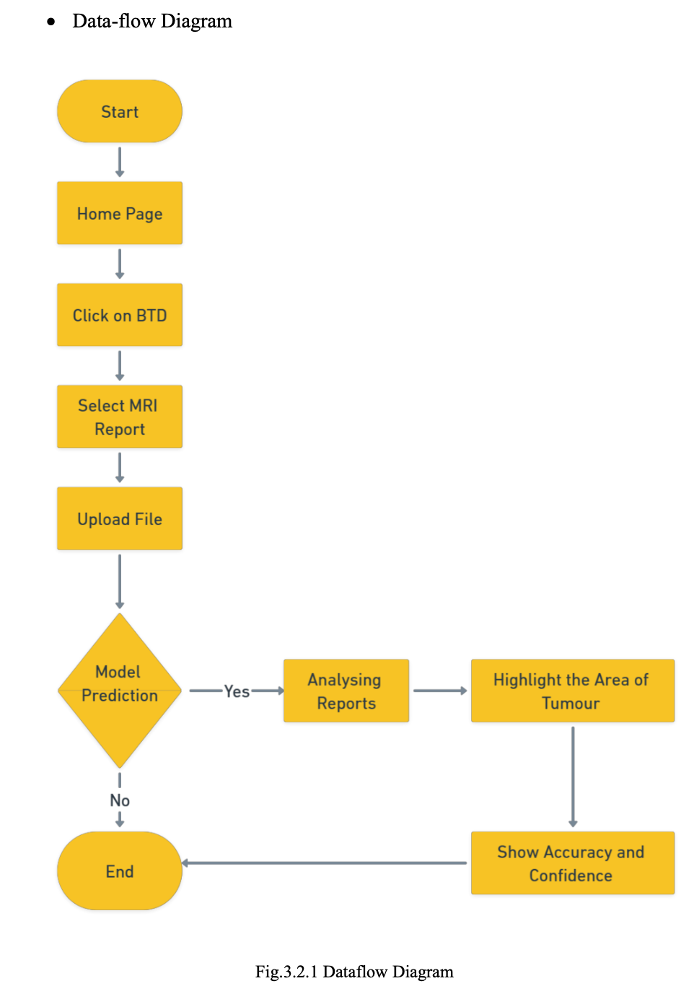
Data-Flow Diagram

Slide 7
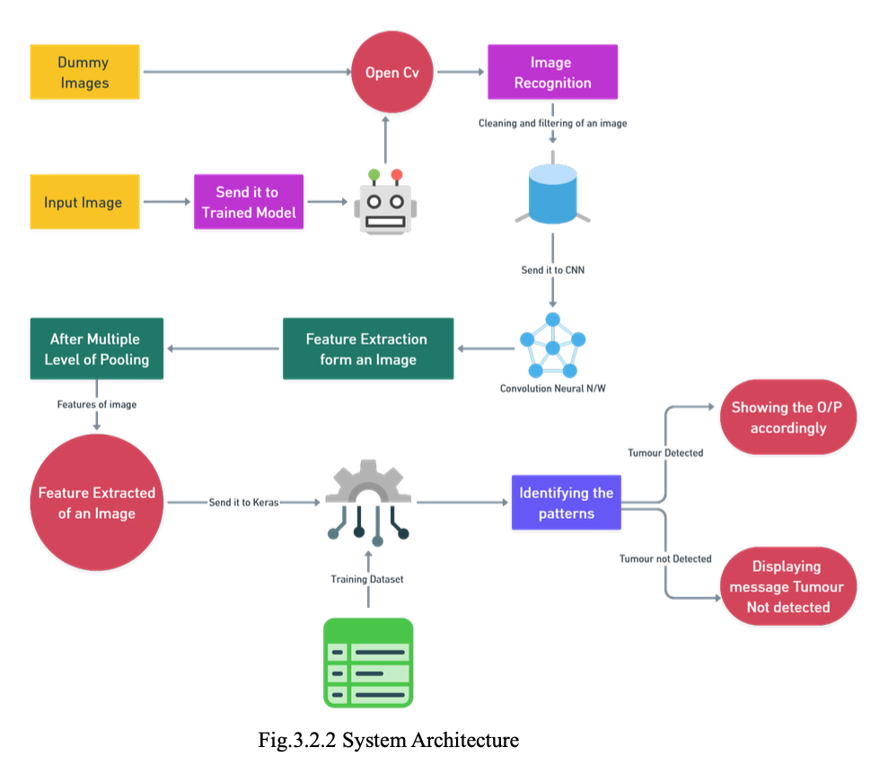
System Architecture

Slide 8
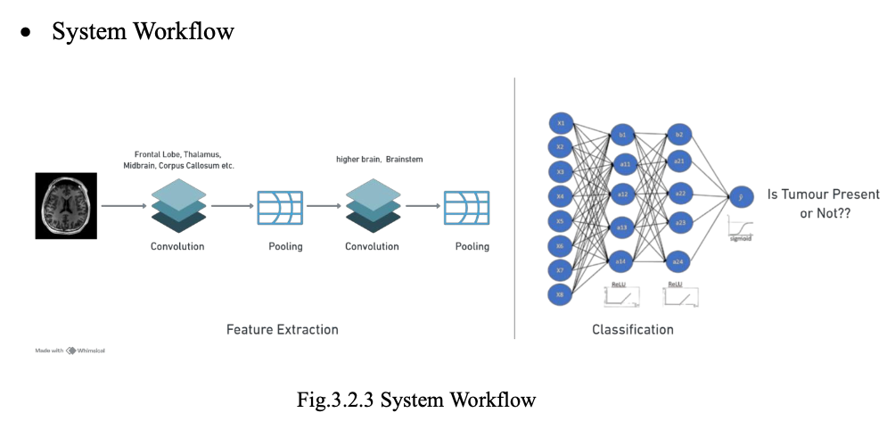
System Workflow

Slide 9
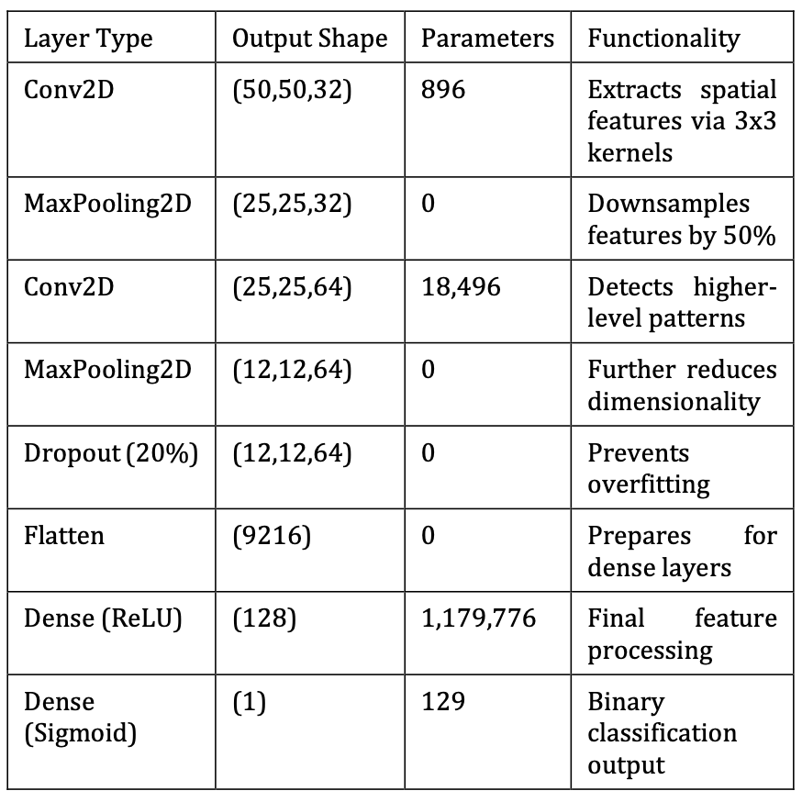
CNN Architecture (Layer Table)

Slide 10
Training Setup
Loss: Binary Cross-Entropy.
Optimizer: Adam/ AdamW (Adaptive learning).
Regularization: Dropout + L2.
Early Stopping prevents overfitting.
Learning Rate Scheduling improves convergence.
Metrics: Accuracy, Precision, Recall, F1, AUC

Slide 11
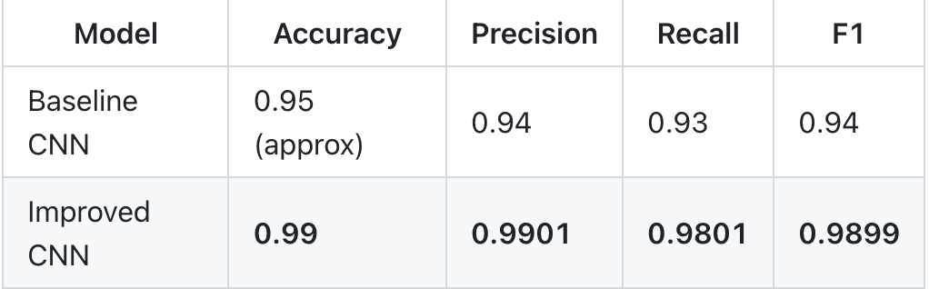
Baseline vs Improved CNN
Baseline CNN: 2 Conv + MaxPool + Dense: Minimal regularization. Faster to train but more prone to overfitting.
Improved CNN: Deeper layers + dropout + regularization: Better feature extraction across tumor scales. Lower generalization error.
Impact of improvement: More stable confidence. Fewer false negatives. Safer for clinical triage.

Slide 12
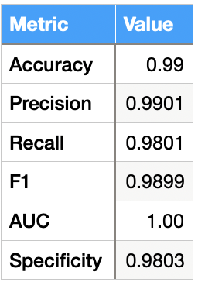
Validation Metrics (Results)

Slide 13
Analysis & Discussion
Recall = 0.98 → very low false negatives.
Precision = 0.99 → few false positives.
AUC = 1.0 → strong class separation. Results suitable for clinical triage support. More diverse datasets needed for generalization.

Slide 14
Limitations
Uses only 2D MRI slices (not volumetric 3D scans).
Dataset size is limited, with restricted diversity.
No patient metadata (age, history, scan type).
Not clinically validated across hospitals.
Performance may drop on unseen scanners.

Slide 15
Future Scope
Transfer learning with ResNet / EfficientNet.
Integrate multi‑modal MRI (T1, T2, FLAIR).
Add Grad‑CAM visual explanations.
Cloud deployment for rural diagnostics.
Automated tumor segmentation and size estimation.

Slide 16
Live Demo!

Slide 17
CONCLUSION
In conclusion, the Brain Tumor Detection System demonstrates that a lightweight CNN can deliver 99% accuracy on validation MRI scans while remaining practical for real‑time use. By combining careful preprocessing, an efficient architecture, and a user‑friendly Streamlit interface, the system reduces diagnostic delay and supports more consistent decision‑making. The strong validation metrics highlight the model’s reliability, and the modular design makes it ready for future expansion with larger datasets, explainable AI, and multi‑modal imaging. Overall, this work provides a solid foundation for AI‑assisted neuro‑diagnostics and a clear pathway toward clinical deployment.
“Every Delayed Diagnosis Is a Life At Risk Tumor Trace Aims To Ensure No Tumor Goes Undetected - Anywhere In The World”

Slide 18
Thank You For Your Attention

